Slide 1
Leveraging Consumer Ignorance and Information Search Costs to Increase Profits in US Wine ‘Flash Sales’
Richard B. Belzer Mount Vernon, VA 22121 USA rbbelzer@post.harvard,edu
American Association of Wine Economists 24 June 24 2011 Bolzano-Bozen IT

Slide 2
What is a ‘flash’ sale?
Retail platform
Internet/social media/email
Impulsive purchase decisions are easy
Fixed or free shipping with minimum purchase
Marketing tactics to increase profit
Large actual or perceived discounts
Induce a sense of urgency
Create appearance of scarcity

Slide 3
Some US Flash Sellers
Cellar Thief
Cinderella Wine
Invino
Wine Spies
Wines ‘til Sold Out
WineShopper
Wired for Wine

Slide 4
Wines ‘Til Sold Out
Attempts to be somewhat anonymous, but unsuccessfully
Billing address shows it is a division of Roger Wilco, Pennsauken NJ
An example of a WTSO sales offer
‘Original Price’
‘Yesterday’s Best Web Price’
‘Our Price (Delivered)’
Percentage Discount (from ‘Original Price’)
Notes:
WHO IS WTSO?
WTSO is a division of Roger Wilco, Pennsauken NJ.
Many other internet wine sellers are located in NJ, suggesting ample room for competition
I requested additional information requested from WTSO to verify its definitions and methods, explaining what I was doing, but the company did not respond.
WHAT DOES AN OFFER LOOK LIKE?
There is promotional text that varies across offers, usually including much ‘wine bullshit’ (Richard Quandt JWE 2007) quoted from various, usually unidentified, sources.
The three prices mentioned earlier, where the sales price equals the delivered price only if the minimum quantity is purchased.
A discount reported in percent, with the highest price used as the baseline.

Slide 5
Hypotheses
WTSO follows flash sale model
WTSO also
Inflated release prices to increase both the apparent discount (and the sales price)
Reports ratings selectively to increase the apparent value (and the sales price)
Length of sale has nothing to do with whether the supply is really sold out

Slide 6
Which Price is the Best Baseline for Judging the Sales Price?
WTSO ‘Original Price’?
Producer’s release price?
Prevailing market price?
Notes:
WTSO uses the ‘original price as the basis for its reported percentage discounts.
WTSO does knows the release price for almost every wine but does not disclose it for any wine.
‘Rational’ consumers should use the prevailing market price, which WTSO appears to provide via a figure from Wine Searcher Pro. All that’s required is to perform the arithmetic. But ‘rational’ is in the eye of the beholder. Consumers often like to pretend that they are saving more money than they really are. For them, the exaggerated percentage discount has psychological value.

Slide 7
How Important Are Ratings?
Notes:
The controversy over wine ratings is not the subject of this paper. I assume only that
Consumers believe ratings have value, especially for unfamiliar wines
Retailers like WTSO believe that consumers believe that ratings have value, especially for unfamiliar wines
Or both
WTSO gains little or no advantage by misreporting ratings, as that practice is clearly deceptive under US consumer protection laws (which vary by State)
WTSO may gain an advantage over consumers if it is selective regarding which ratings it disclosed, a practice that may be deceptive but is probably legal under US consumer protection laws.
I hypothesize that WTSO in fact does practice selective disclosure. I call this practice ‘misleading’ (because it clearly is) rather than ‘deceptive’ (which has a specific legal meaning.
This slide shows a clean-cut case in which WTSO misleads consumers by reporting ratings selectively. For this wine—Bodegas Uvaguilera Aguilera Palomero 2000—Wine Advocate reports two ratings, one from April 2004 and a a second from June 2005. The earlier rating, a 93, is much higher than the later rating, an 89. WTSO reports only the earlier rating.

Slide 8
WTSO Study Data
All offers made since 15 July 2009
> 2,500 total
422 sales from 15 July 2009–30 Nov 2009
Date/Time Stamps
Price Data
Ratings
Notes:
Only data that have passed QA/QC are included
As many as cases are excluded from most analysis for various reasons.

Slide 9
Supplementary Data
From WS, WA, and/or ST
Release prices
Ratings
From some producers
Release prices
Excluded from this analysis because inclusion imparts a US bias
Notes:
Release price data from producers is usually available from a US producer, provided that:
The producer has a web site
The wine is a current release
Regression analyses require release prices and:
US producers are much more likely to have a web site with prices
WTSO’s non-US wines are more likely to be non-current releases
Suggestions for how to cost-effectively obtain release prices from non-US producers is greatly appreciated.

Slide 10
Caveats
Price and ratings data are seriously incomplete, making inferences dicey
2,500+ offers in my database
423 offers in my sample
260 offers have complete price and ratings data; regression analyses are based on this subsample
Unknowns: known and unknown
Is WTSO representative of the flash sale market?
Is the sample representative of WTSO?
Is the subsample representative of the sample?

Slide 11
Disinformation about price

Slide 12
Price Statistics
 |  | WTSO 'Original Price' ($) | Average Reported Release Price ($) | Prevailing Market Price** ($) | WTSO Sale Price ($)
N | Valid | 422 | 256 | 421 | 422
 | Missing | 0 | 166 | 1 | 0
Mean |  | $58.00 | $59.76 | $46.90 | $28.78
Median |  | $39.99 | $45.25 | $34.12 | $19.99
Std. Deviation |  | $74.55 | $64.83 | $55.19 | $31.64
* As reported by WS, WA, and/or ST. ** Defined as ‘Yesterday’s Best Web Price
Notes:
Descriptive statistics should be interpreted with care.
The average ‘Original Price’ is less than the average reported release price. However, the average difference between these prices is 30%.
The average prevailing market price exceeds the Release Price is 21% But the average difference in these prices is only 1%.

Slide 13
Differences Between Adjacent Price Variables
 | Original Price – Release Price | Release Price – Prevailing Market Price | Prevailing Market Price – Sales Price
Mean | $11.56 | $3.23 | $18.10
Median | $5.99 | $1.16 | $13.00
Std. Deviation | $29.81 | $15.93 | $28.27
Valid N | 260 | 260 | 421

Slide 14
Average Ratings Reported by WTSO v. Raters Themselves
Independent Rater |  | Average Independent Rating Reported by WTSO | Average Independent Rating
Wine Spectator (WS) | Mean | 90.9 | 88.3
 | N | 65 | 160
Wine Advocate (WA) | Mean | 91.8 | 90.6
 | N | 68 | 113
Stephen Tanzer (ST) | Mean | 91.4 | 90.7
 | N | 47 | 92
Differences are statistically significant at p < .001

Slide 15
Misinformation about perceived quality

Slide 16
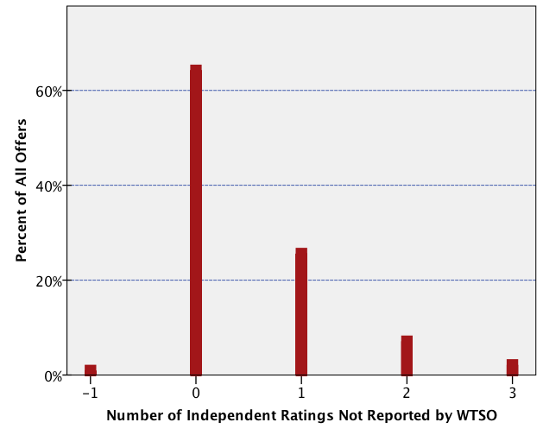
Number of Independent Ratings Not Reported by WTSO
Notes:
For 108 offers, WTSO failed to report one independent rating
For 39 offers, it failed to report two or more ratings.
N.B. In 4 cases, WTSO over-reported independent ratings by reporting ratings for the wrong wine, which in every case was superior to the actual wine being offered for sale. Because the number is so small, I infer accident rather than intent.

Slide 17
Actual Ratings v Ratings Reported by WTSO
 |  |  | Number of WS, WA, and ST Ratings Available |  |  |  | Total
 |  |  | 0 | 1 | 2 | 3
Number of WS, WA, and ST Ratings Reported by WTSO | 0 | Count | 205 | 64 | 12 | 9 | 290
 |  | Exp’d | 206 | 0 | 0 | 0 | 290
 | 1 | Count | 1 | 44 | 29 | 18 | 92
 |  | Exp’d | 0 | 110 | 0 | 0 | 92
 | 2 | Count | 0 | 2 | 16 | 15 | 33
 |  | Exp’d | 0 | 0 | 58 | 0 | 33
 | 3 | Count | 0 | 0 | 1 | 6 | 7
 |  | Exp’d | 0 | 0 | 0 | 48 | 7
Total |  |  | 206 | 110 | 58 | 48 | 422
Notes:
WHAT DOES THIS TABLE SHOW?
The columns are the number of ratings available from WS, WA, and ST.
The rows are the number of ratings from WS, WA, and ST that WTSO reported.
If WTSO reported ratings fairly, all the data would be on the green diagonal.
WTSO SYSTEMATICALLY EXCLUDES RATINGS
These exclusions are in the red cells to the right of the green diagonal.
WTSO SYSTEMATICALLY EXCLUDES LOW RATINGS
This was evident from the difference in the average rating, two slides ago.
WTSO SYSTEMATICALLY EXCLUDES LOW RATINGS BY INTENT
The benefit to WTSO is obvious: to portray a wine as better as than it is, and thus worthy a higher price.
The nature of WTSO’s exclusions rules out accident or incompetence.

Slide 18
Not really ‘til sold out’

Slide 19
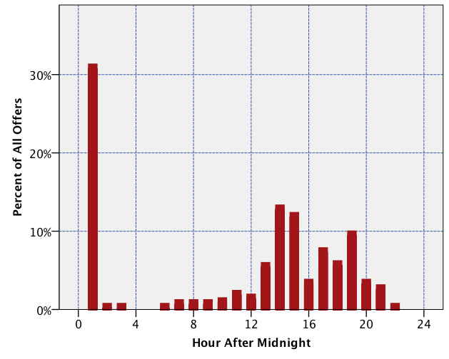
Offers by Time of Day
Notes:
If WTSO actually sells out each wine before offering another for sale, then the number (and percent) of offers by time of day should appear to be random.
They are obviously not random
About 1/3 of all offers are made between midnight and 4:00 am.
Another 1/3 are made mid-day.
The remainder are made during the late afternoon or early evening.
Plausible characteristics of the wines being offer, such as the Country/Stare of origin, the sale price, or the average number of points do not predict the time of day an offer was made.

Slide 20
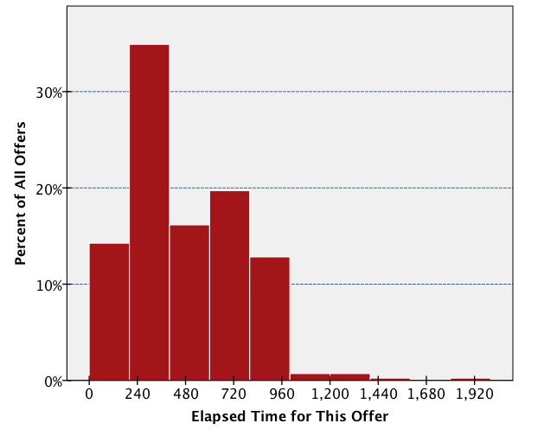
Elapsed Time Between Offers
Notes:
The elapsed time between offers is a rough proxy (and maximum) of the length of time the preceding wine was on offer.
This distribution is not random, to be sure, and the usual wine characteristics such as Country/State of origin, rating, and price, do not predict the elapsed time.
Therefore, I conclude that WTSO does not actually sell out each wine before putting out an offer for the next.
Further supporting evidence can be gleaned by noting that WTSO sells the same wine numerous times.

Slide 21
Does WTSO profit from these practices?
Notes:
HYPOTHESIS TESTS
I have devised ways to test two of the three hypotheses:
Does WTSO profit from disinformation about price?
Does WTSO profit from misinformation about quality?
I have not devised a way to test whether WTSO profits from ambiguity over the length of time each offer is open

Slide 22
Regression Model
Dependent Variable = Sales Price
Independent Variables
Fixed Effects
Country/State Effects Perceived Quality (Ratings) Prevailing Market Price
Producer’s Wishful Surplus
Test Variables
Disinformation about Price
Misinformation about Quality

Slide 23
Variables Explained
Producer’s Wishful Surplus (PWS)
Release Price – Prevailing Market Price
Profit from Disinformation about Price
‘Original Price’ – Release Price
Profit from Misinformation about Quality
Avg WTSO-reported rating – Avg Actual Rating
Notes:
PRODUCER’S WISHFUL SURPLUS
Producers set release prices based on what they wish their wines would sell for in the market
Producers work very hard to try to maintain these prices and to deter discounting.
Wine clubs, Allocations, Waiting lists, Waiting lists for wine clubs, Waiting list for allocations.
Innovative ways to discount without appearing to discount.
Case discounts, Club discounts, Package deals, Free shipping, Work quietly in tandem with a flash seller (e.g., Wine Spies).
Usually, these efforts are only partially successful.
PWS is the amount by which the producer’s release price exceeds the prevailing market price
Thus surplus is wishful, but sometimes wishes come true
We cannot know how much of PWS is captured by whom—producer, wholesaler, retailer.
PROFITING FROM DISINFORMATION ABOUT PRICE
The release price (or, in rare case, the greater of the release price and the prevailing market price) is an upper bound for baseline price
Any amount above this is imaginary.
If a seller can persuade a buyer that he imaginary is real, the seller can make an excess profit; does WTSO make an excess profit by doing so?
PROFITING FROM MISINFORMATION ABOUT QUALITY
Wine ratings are a market-driven proxy for quality.
Reporting ratings selectively is an of misinformation.
WTSO reports ratings selectively; does it make an excess profit from doing so?

Slide 24
Alternative Models (N Vars)
Model I
Country/State (12)
Perceived Quality (1)
Prevailing Market Price (1)
PWS (1)
Disinformation about Price (1)
Misinformation about Quality (1)
Model II
Country/State (12)
Perceived Quality (1)
Prevailing Market Price (13)
PWS (1)
Disinformation about Price (1) Misinformation about Quality (12)
Notes:
THE MODELS ARE THE SAME INSOFAR AS THEY CONTROL FOR FACTORS EXOGENOUS TO WTSO’S BUSINESS PRACTICES
Country/State of origin
Perceived quality, as measured by ratings
Prevailing market price
Producer’s Wishful Surplus
Test variables for the two hypotheses
TWO MODELS ARE DIFFERENT VARY WITH RESPECT TO HOW THEY CONTROL FOR EXOGENOUS FACTORS AND 1 TEST VARIABLE
In Model II, prevailing market prices are estimated separately for each Country and State
In Model II, the effect of misinformation about quality is estimated separately for each Country and State
A POSSIBLE MODEL III
Estimate perceived quality separately for each Country and State
Estimate PWS separately for each Country and State
Estimate the effect of disinformation about price separately for each Country and State

Slide 25
Regression Results (1)
 | Model I |  | Model II
Adjusted R² | .961 |  | .977
 | B | Sig. | B | Sig.
COUNTRY/STATE EFFECTS
AR | -18.787 | .003 | -13.182 |  | .956
AU | -3.628 | .244 | 8.603 |  | .086
CA [Constant] | 5.209 | .045 | -9.661 |  | .009
CH | -9.902 | .319 | ⎯ |  | ⎯
ES | -9.293 | .001 | 9.863 |  | .043
FR | -.152 | .967 | 15.932 |  | .002
IT | -.053 | .984 | 7.803 |  | .096
PT | -4.990 | .615 | ⎯ |  | ⎯
WA | 3.015 | .764 | ⎯ |  | ⎯
ZA | 1.657 | .818 | 11.881 |  | .146
Notes:
REGRESSION RESULS
ARE PRESENTED ON FIVE SLIDES SO THAT THEY ARE READABLE
ESTIMATES THAT ARE STATISTICALLY SIGNIFICANT AT P (.05) ARE HIGHLIGHTED
UNITS ARE $//BOTTLE
SLIDE I: Country/State effects
PT and WA, which were not statistically significant in Model I, drop out of model II because of perfect collinearity with an interaction term
CA, ES, and FR:
Model specification is crucial
CA: $15/bottle change
ES: $19/bottle change
FR: $16/bottle change
What Model I explains as country/state effects is explained elsewhere in Model II
What Model II explains as a country effect for FR was hidden elsewhere in Model I

Slide 26
Regression Results (1I)
 |  | Model I |  |  | Model II
Adjusted R² |  | .961 |  |  | .977
 |  | B | Sig. |  | B | Sig.
PERCEIVED QUALITY EFFECTS
Avg Points from 90 | 2.545 |  | .000 | .869 |  | .169
PREVAILING MARKET PRICE
‘Yesterday's Best Web Price’, Premium Wines Only |  | ⎯ | ⎯ |  | -.032 | .404
Notes:
SLIDE II: Effects of quality, as measured by ratings
Model I showed sales price was $2.50 higher per bottle per average point undisclosed by WTSO
This largely vanished in Model II. Where did it go?
Model II includes a dummy variable for wines in which the prevailing market price exceeded the release price
Theory was that the market for these wines might be fundamentally different
Theory is not supported by evidence.

Slide 27
Regression Results (III)
 | Model I |  |  | Model II
Adjusted R² | .961 |  |  | .977
 | B |  | Sig. | B | Sig.
PREVAILING MARKET PRICE
ALL | .473 | .000 |  | ⎯ | ⎯
AR | ⎯ | ⎯ |  | -.127 | .948
AU | ⎯ | ⎯ |  | -.083 | .377
CA | ⎯ | ⎯ |  | .700 | .000
ES | ⎯ | ⎯ |  | -.262 | .000
FR | ⎯ | ⎯ |  | -.289 | .000
IT | ⎯ | ⎯ |  | -.101 | .087
PT | ⎯ | ⎯ |  | .069 | .680
WA | ⎯ | ⎯ |  | .505 | .273
Notes:
SLIDE III: Effects of prevailing market prices
Some of the Country/State effects in Model I for CA and ES have moved here
For CA, the sales price is 70 cents higher per bottle for every dollar of prevailing market price
For ES and FR, the sales price is lower by 26 and 29 cents per bottle, respectively for every dollar of prevailing market price
I think this means US consumers were gun-shy about expensive Spanish and French wines

Slide 28
Regression Results (IV)
 | Model I |  | Model II
Adjusted R² | .961 |  | .977
 | B | Sig. | B | Sig.
PRODUCER’S WISHFUL SURPLUS
Release Price – ‘Yesterday's Best Web Price’ | .724 | .000 | .573 |  | .000
PROFIT FROM DISINFORMATION ABOUT PRICE
‘Original Price’ - Release Price | .152 | .001 | .300 |  | .000
Notes:
SLIDE IV: Producer’s Wishful Surplus and profit from disinformation about price
Models are consistent in showing that PWS contributes to the sales price
For every dollar by which the release price exceeds the prevailing market price
Model I: 72 cents per bottle higher
Model I: 57 cents per bottle higher
Model I shows WTSO profiting by exaggerating release prices
But not much, just 15 cents per bottle per dollar of exaggeration

Slide 29
Regression Results (V)
 | Model I |  | Model II
Adjusted R² | .961 |  | .977
 | B | Sig. | B | Sig.
PROFIT FROM MISINFORMATION ABOUT QUALITY
WTSO Rating – Actual Rating (ALL) | 2.899 | .001 | ⎯ | ⎯
AR | ⎯ | ⎯ | 6.860 | .925
AU | ⎯ | ⎯ | -.463 | .805
CA | ⎯ | ⎯ | .684 | .554
CH | ⎯ | ⎯ | -3.959 | .615
ES | ⎯ | ⎯ | .534 | .735
FR | ⎯ | ⎯ | 10.641 | .000
IT | ⎯ | ⎯ | .740 | .601
ZA | ⎯ | ⎯ | -2.622 | .635
Notes:
SLIDE V: Model II profits of misinformation about quality
Model I: Estimates a constant value across all Countries and States
Almost $3 per bottle per average rating point undisclosed
This is a huge incentive to mislead consumers about quality
Model II: Estimates different values by Country/State of origin
Only FR is both large and statistically significant: more than $10.50 per bottle per average point undisclosed
More data might reduce the standard errors such that other coefficients would become statistically significant
If so, then the analysis tells WTSO that it should NOT misinform consumers about ratings with respect to Chilean and South African wines

Slide 30
Conclusions
WTSO appears to profit from disinformation about price and misinformation about quality
Profit from disinformation about price is small
Profit from misinformation about quality is limited to French wines
Caveats again
The subsample may not be representative
WTSO wines may not be representative
WTSO may not be representative

Slide 31
Questions and Comments
Richard B Belzer
PO Box 319
Mount Vernon, VA 232121 USA
+1 703.780.1850
rbbelzer@post.harvard.edu

Slide 32
Wines ‘Til Sold Out
Who is WinesTilSoldOut?
‘We sell one wine at a time from midnight eastern standard time until sold out, when it is replaced by another offer but rarely more than 4 wines per day.’
How do you determine comparable or "Best Web Price"?
‘We use Wine Searcher Pro and Google to find the lowest price offered in the US. The day before an item is scheduled, a purchase is initiated at the store displaying the lowest price, for a comparable number of bottles shipped to the middle of the country (usually Chicago).’
I missed yesterday's item, can I still get one?
‘No. The last product is discontinued at 11:59pm EST’
Will WTSO ever tell us how many cases or bottles remain available in a given sale?
‘No. That's not the way it works. Some lots are hundreds of cases, while others are just a few. Where's the fun if you knew?’
https://www.wtso.com/content.php?cms_id=2

