Slide 1
COVID-19 as a Natural Experiment Testing the Precautionary Principle
Society for Risk Analysis
2021 Annual Meeting
December 8, 2021
Richard B. Belzer Good Intentions Paving Co. screwtape@goodintentionspaving.co

Slide 2
Core Elements of the Precautionary Principle¹
PP Element | Principle
Focus on target risk | Target risk minimization without constraints
Timing of decision-making | Act before ‘formal justification of proof’
Proportionality of action | Actions should be cost-effective²
(A) Science has no material role in decision-making (B) Decisions should be modified to account for new scientific information | (A) PP is ‘an overarching principle to guide decision making in the absence of analytical or predictive certainty’³ (B) ‘all decisions should be open to review and revision based on new knowledge and experience’²
Burden of proof | Burden is very high and imposed on ‘those who propose change’
Intergenerational equity | No discounting of future effects
Public participation | Democratic
¹ Jordan & O’Riordan 1999 (25-26); ² Myers & Montague 2006 (123-124). ³ Santillo et al 1999 (39).

Slide 3
Core Elements of the Precautionary Principle¹
PP Element | Principle
Focus on target risk | Target risk minimization without constraints
Timing of decision-making | Act before ‘formal justification of proof’
Proportionality of action | Actions should be cost-effective²
(A) Science has no material role in decision-making (B) Decisions should be modified to account for new scientific information | (A) ‘An overarching principle to guide decision making in the absence of analytical or predictive certainty’³ (B) ‘All decisions should be open to review and revision based on new knowledge and experience’²
Burden of proof | Burden is very high and imposed on ‘those who propose change’
Intergenerational equity | No discounting of future effects
Public participation | Democratic
¹ Jordan & O’Riordan 1999 (25-26); ² Myers & Montague 2006 (123-124). ³ Santillo et al 1999 (39).

Slide 4
Focus on target risk
Target risk minimization without constraints
The risk goal changed early and often:
‘Avoid ICU overcapacity’
…then ‘minimize cases’
…then ‘achieve herd immunity’
…then ’universal vaccination’
What’s next?
Some actions increased target risk
All actions subject to severe data quality error

Slide 5
Timing of decision-making
Consistent with PP, except
Actions were based on opaque modeling informed by arbitrary assumptions, bad or manufactured data
Errors once detected were defended, not corrected

Slide 6
Proportionality of response
Actions inconsistent with PP, because
Iterative and inconsistent target risk definition
Cost-effectiveness impossible without benefit assessments (which were not performed)
Decision-makers relied on diktats (e.g., masks, ‘social distancing’, lockdowns, school closures, vaccine mandates, quarantines)
Some decision-makers willfully increased mortality (e.g., hospital discharges to LTCFs)

Slide 7
Role of science
PP appears incoherent: How can science have no material role and be used to modify decisions?
Easy resolution
Scientific information suggesting risk, regardless of quality, is always dispositive
Scientific information suggesting safety, regardless of quality, is never dispositive

Slide 8
Burden of proof
Selective application: If burden of proof shifts to ‘those who propose change,’ how did COVID decision-makers evade it?
Easy resolution
Burden was not shifted to any public institutions imposing regulations
Burden was shifted to individuals and private entities challenging governmental edicts

Slide 9
Intergenerational equity
Actions inconsistent with PP
Abandonment of elderly in LTCFs
School closures
Long-term vaccine side-effects

Slide 10
Public participation
Actions inconsistent with PP
Autocratic decision-making
Misleading/mendacious risk communication
Elite noncompliance with PP-based decisions
Rank hypocrisy among public health experts
Censorship and suppression of dissent, beginning within science and expanding throughout media and government

Slide 11
Consequences of the Precautionary Principle
Government officials
Not trusted to responsibly exercise power
Managing the next pandemic requires even more repression
Public health ‘experts’
Viewed as scientifically corrupt partisans
Massive defunding should be expected
Risk analysts
Irrelevant

Slide 12
The Precautionary Principle is Irredeemably Marxist

Slide 13
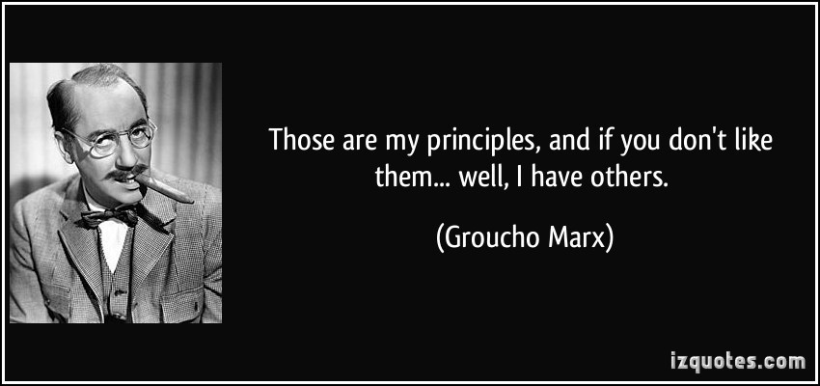
The Precautionary Principle is Irredeemably Marxist

